Slide 1
Electronic Devices and Circuits Lab 02
Lab overview

Slide 2
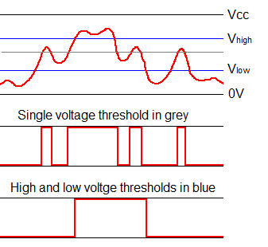
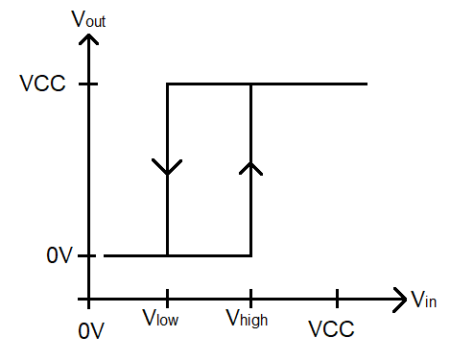
Schmitt trigger
Good for noise rejection
Analog signal (top) converted with a single threshold (middle) then Schmitt trigger (bottom).

Slide 3
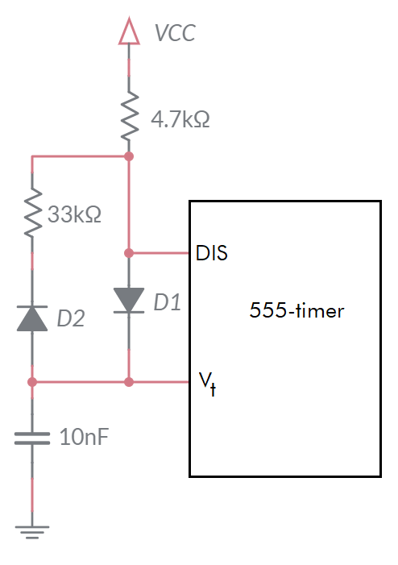
555-Timer analysis
Charging Mode
4.7k and 10nF in series
Determine time to charge cap from 3V to 6V
Discharging Mode
33k and 10nF in series
Determine time to discharge cap from 6V to 3V

Slide 4
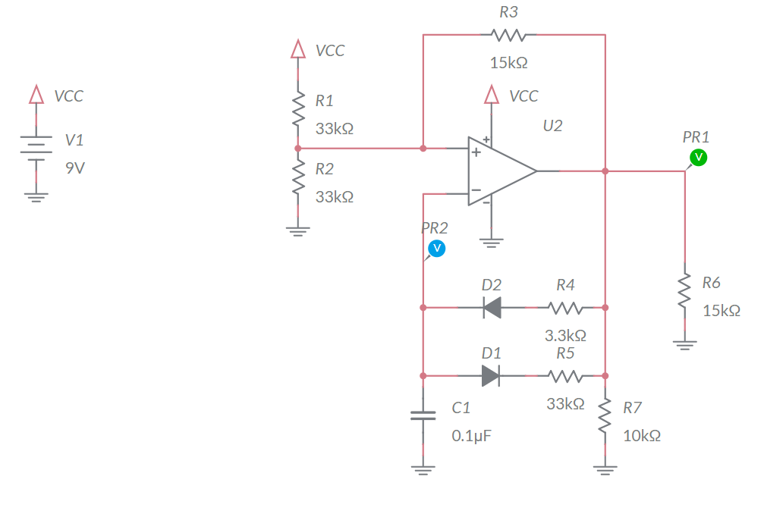
Analyze
VCC = 9V
Assume Vout = 9V
C1 charges through R4
V- increase through
Causing Vout = 0V
Assume Vout = 0V
C1 discharges through R5
V- decreases
Causing Vout = 9V

Slide 5
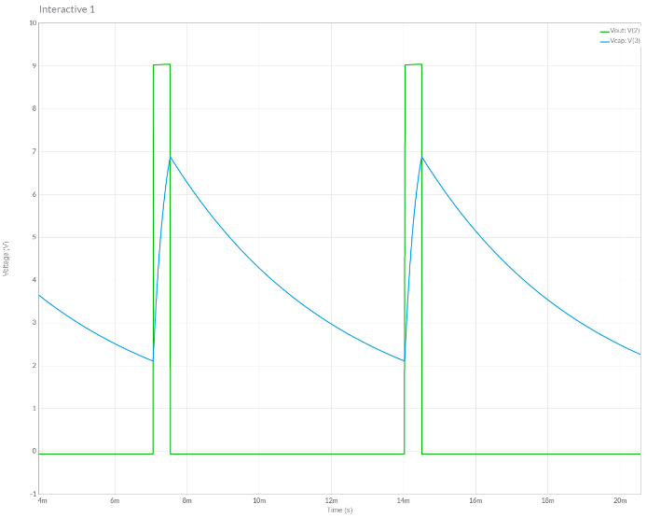
Simulation
Use MultiSim Live
Set initial conditions on capacitor
Probe op amp output and capacitor voltage

Slide 6
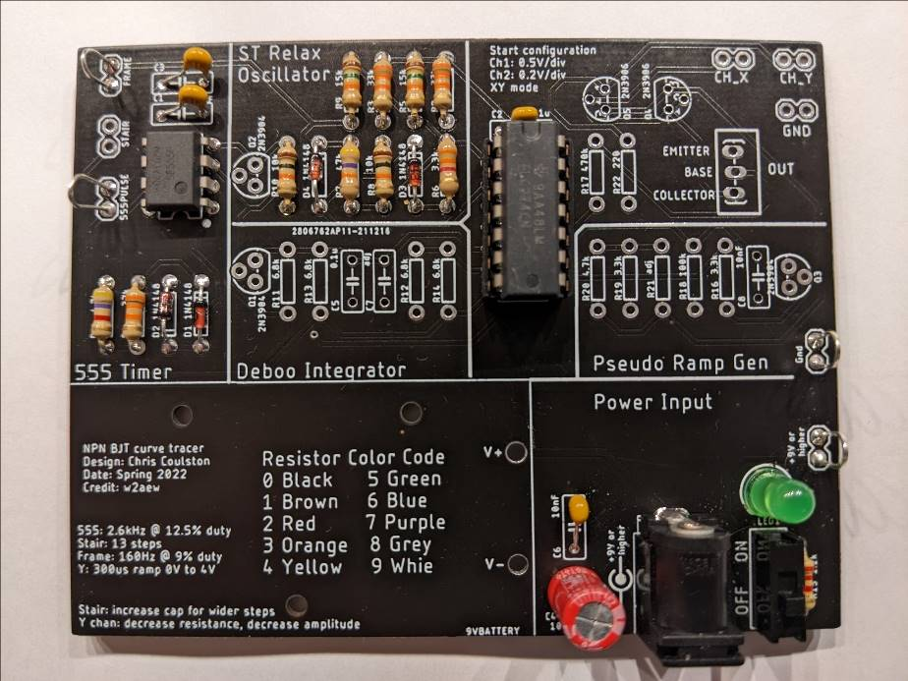
Assemble
Capacitor is adjacent to TLC274
Use 14-pin socket for TLC274

Slide 7
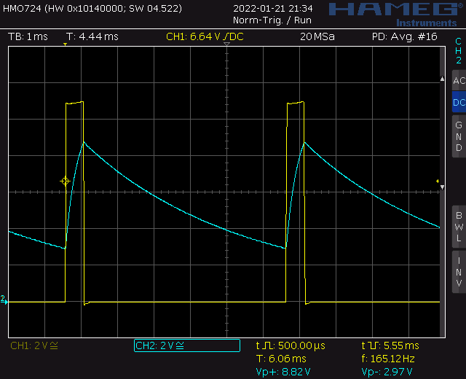
Test
Probe op amp output and capacitor voltage
Should be close (within 25%) to simulation

Slide 8
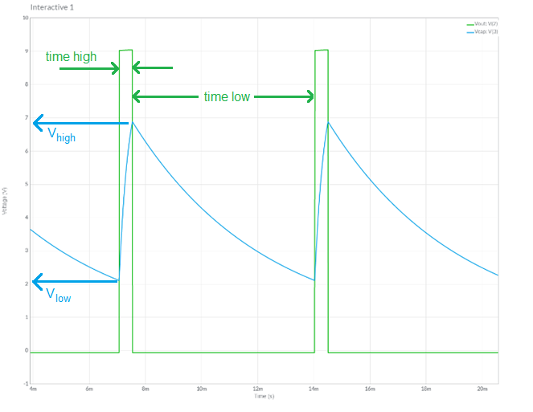
Turn in
Summary of analysis, simulation and assemble
Table 4 op amp output
Table 5 capacitor C1
Answer listed questions
Save solutions as PDF
Due before start of class next week
Every student builds their own board
Everyone brings their board to class

